Slide 1






TASK 1
Model 1
Insurance Underwriting Model
TASK 2
Model 1
Validation
Preparation
Data Collection
& Pre-processing
Quantify risks
Minimum Viable Premium
For Insurers
Property Owners’ Behavior Factor
Texas in USA
High Income & High assets
Mature Insurance Market
hurricanes & winter storms.
Accumulate losses
Maximum Affordable Premium
For Homeowners
Luzon in Philippine
Developing Region
Immature Insurance Market
Typhoon & Flooding
Solvency Constraint
Decision Inequation
Insurance Market Failure Point
TASK 3
Model 2
Dynamic Resilience Life-Cycle Cost Model
TASK 4
Model 3
Cultural Relics Protection Model
Initial Construction Cost
Economic value
Intangible Cultural Value
Protection Index
(PI)
Protective Measures Cost
Expected Residual Loss
Minimum Viable Premium
Minimize Total Cost of
Ownership (TCO)
TASK 5
Letter Writing
To Mayor and City Council of San Antonio,
Climate Resilience Bonds should be applied to protect the Saint Antonio Missions Historical Park
Expected Residual Loss
Optimal Resilience Level

Slide 2








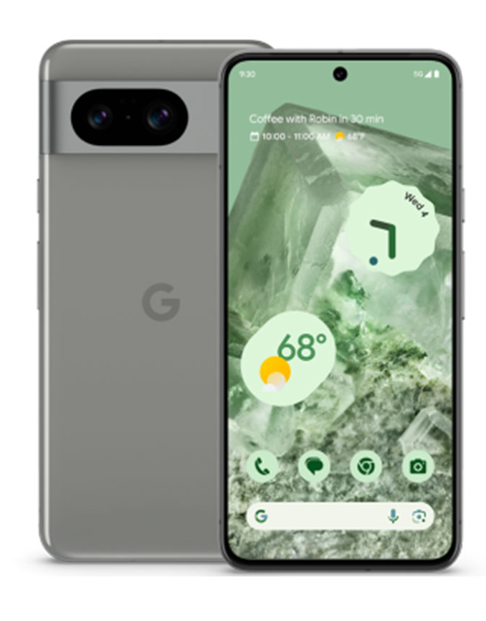

Base Power Consumption
GPS Power Consumption
Thevenin Equivalent Circuit Model
Definition of SOC
Kirchhoff laws
Network Power Consumption
GPU&CPU
Consumption
Screen Power Consumption
Lithium-ion Equivalent
Circuit Model
LECM
Multi-factor Coupled Power
Consumption Model
MCPCM
Dataset Preparation
Based on Google Pixel 8
Internal Resistance
Battery
Capacity
Temperature
Aging
Temperature
Cycle Times
Sensitivity Analysis
Base Power
Model Validation
4 scenarios
Mixed Usage
Daliy Usage
For Users
Advice For Users
and Enterprises
For Enterprises
Light Usage
E-Books Reading
Medium Usage
Videos Watching
Heavy Usage
Gaming

Slide 3
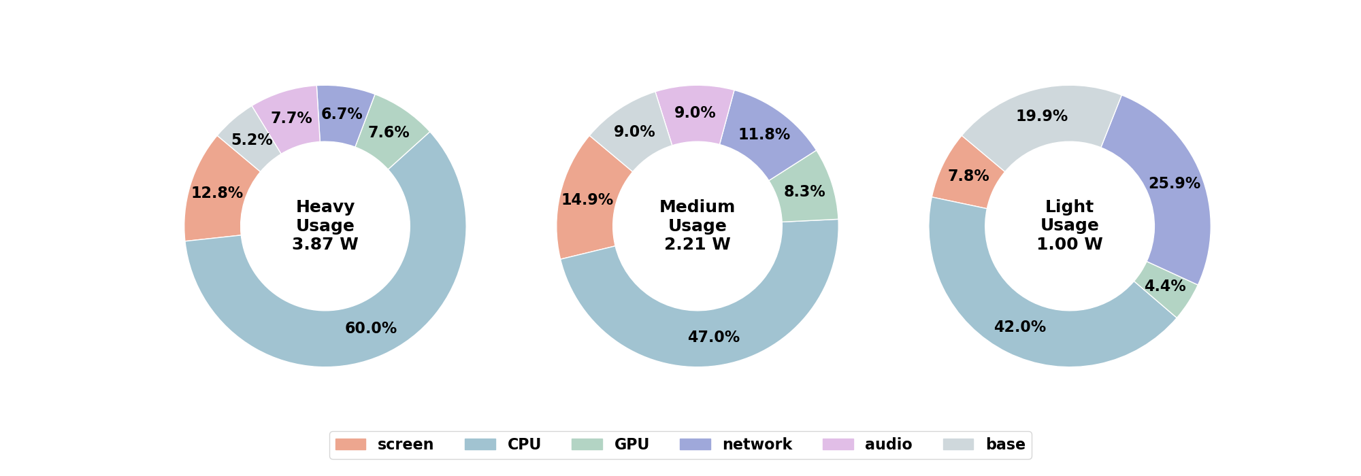


Slide 4



Light Usage
Medium Usage
Heavy Usage
CPU Big Core = 600MHZ
CPU Mid Core = 800MHZ
CPU Little Core = 800MHZ
GPU = 200MHZ
Brightness = 30%
Audio = off
Cellular = off
WiFi = 0MB/S
CPU Big Core = 1.2GHZ
CPU Mid Core = 2GHZ
CPU Little Core = 1.25GHZ
GPU = 600MHZ
Brightness = 60%
Audio = on
Cellular = off
WiFi = 5MB/S
CPU Big Core = 1.8GHZ
CPU Mid Core = 3GMHZ
CPU Little Core = 2.2GMHZ
GPU = 800MHZ
Brightness = 100%
Audio = on
Cellular = off
WiFi = 1MB/S

Slide 5
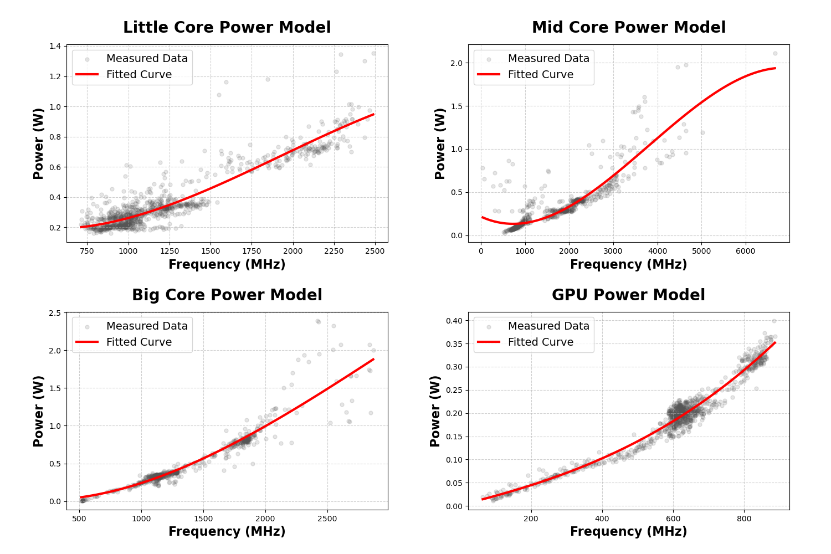
Heavy
Heavy
Light
Medium
Light
Medium
Heavy
Medium
Heavy
Medium
Light
Light

Slide 6
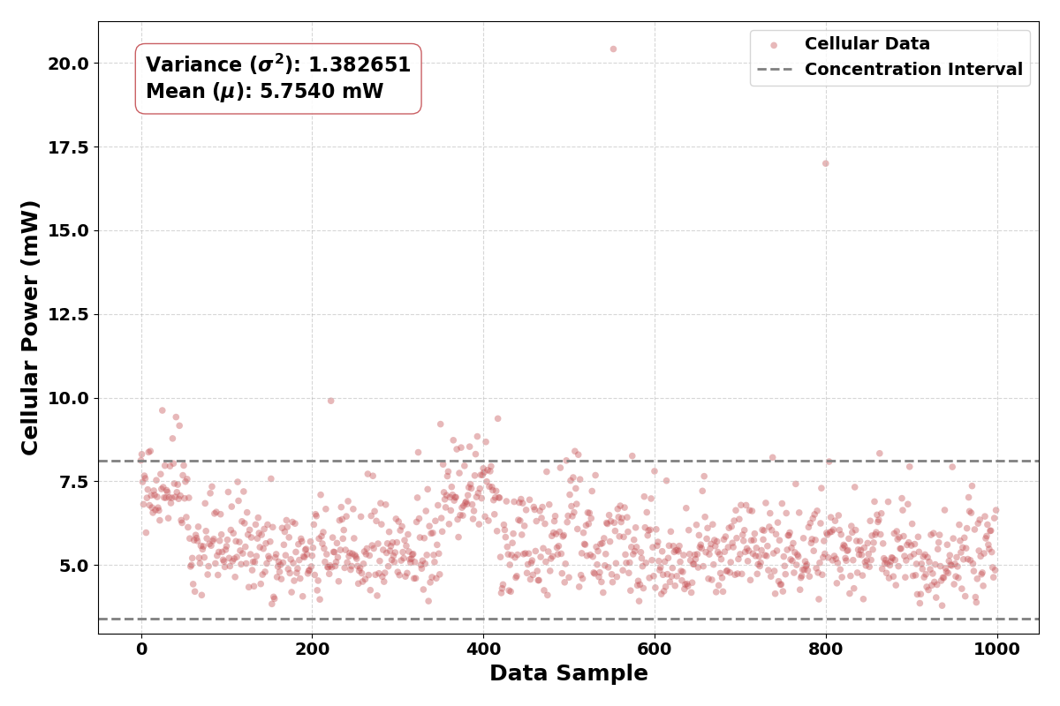
6.90
4.57

Slide 7
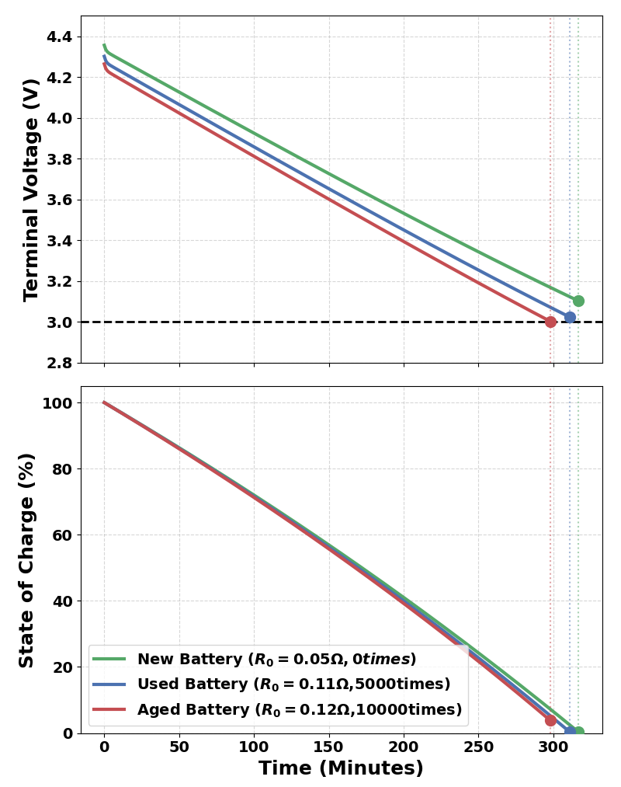
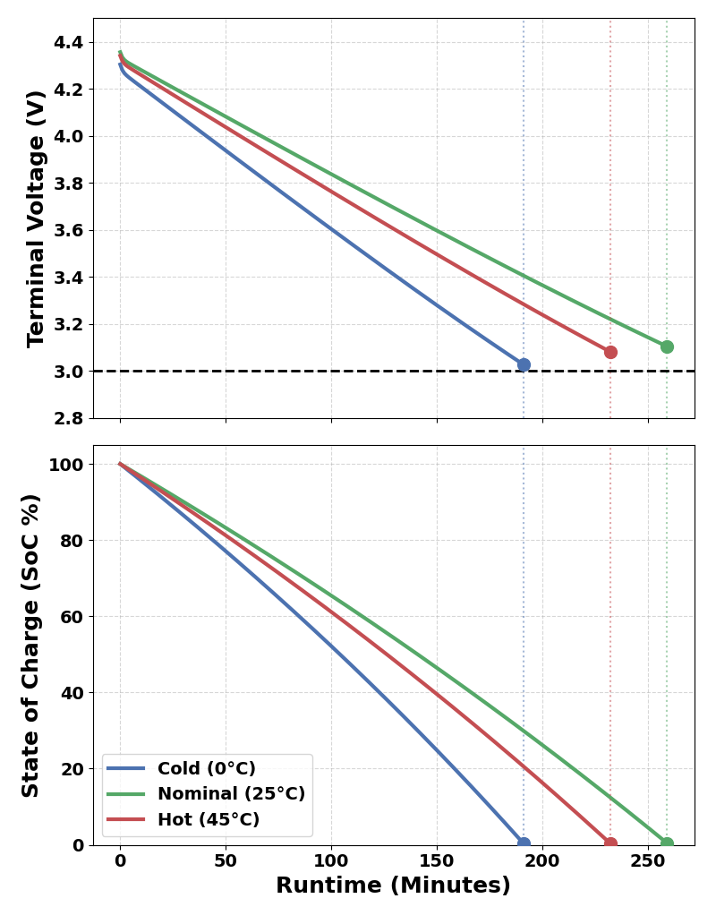

Slide 8
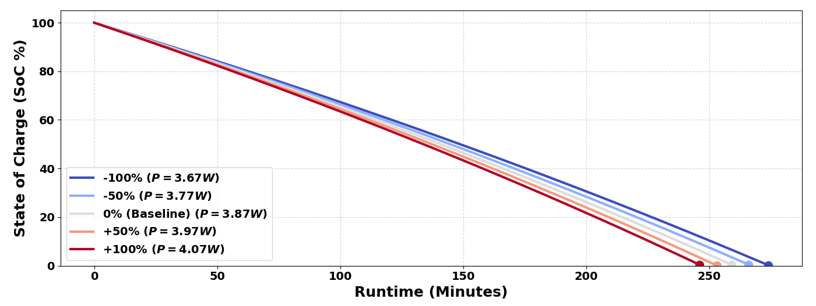
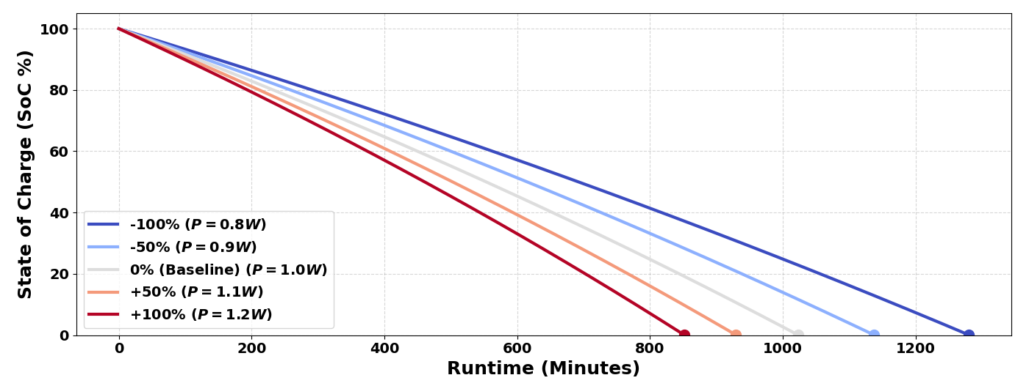

Slide 9

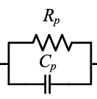

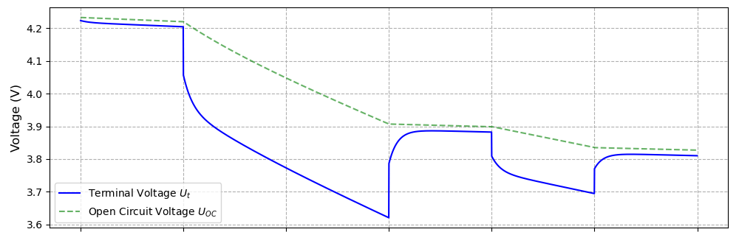
Voltage
Drop
Resistance
Recovery

